Slide 1

I-Schedule
Amisha Gupta, Hunter Ochabauer, Dylan Drumm, and Ariful Hoq

Slide 2
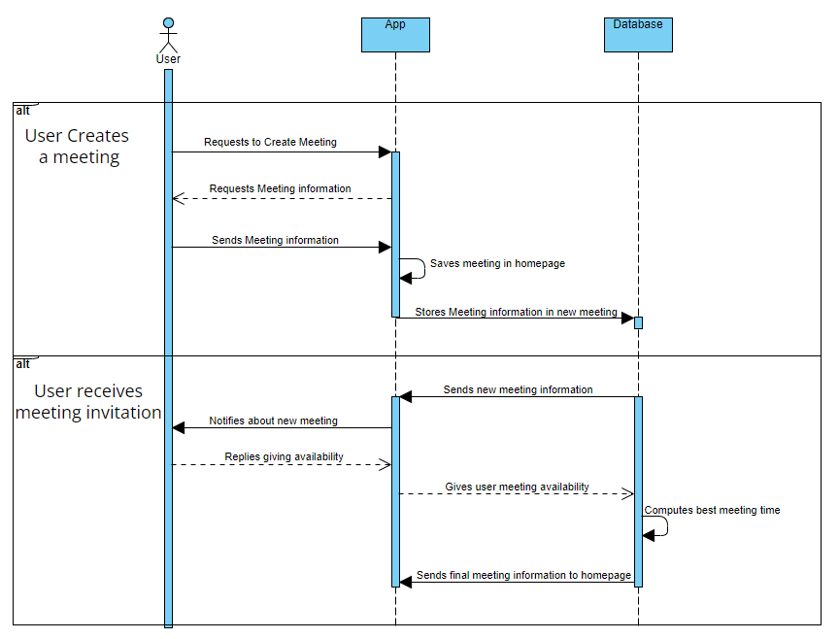
UML Sequence Diagram
There are 2 ways to interact with the app, being a meeting creator, or a meeting invitee.
Meeting creators request to make a meeting from the app. The app asks all of the details regarding the meeting. The user responds with the information, and that information is saved in the homepage and the database
Meeting invitees receive a meeting invitation from the app which came from the database. They respond with their availability, and the database computes the best meeting time which is saved to the user’s homepage.

Slide 3
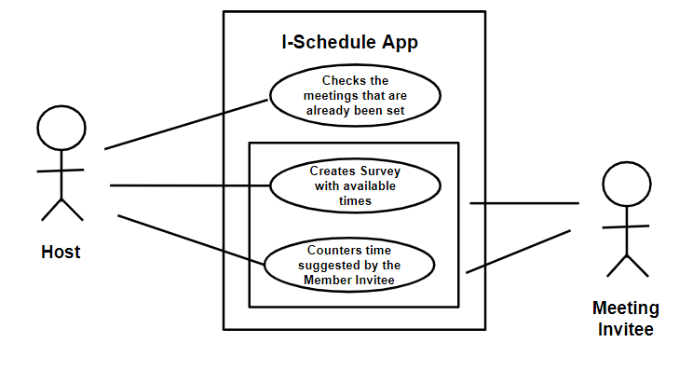
Use Case Diagram 1- Creating meeting with one invitee
Receives Survey
Sends survey back with counter time

Slide 4
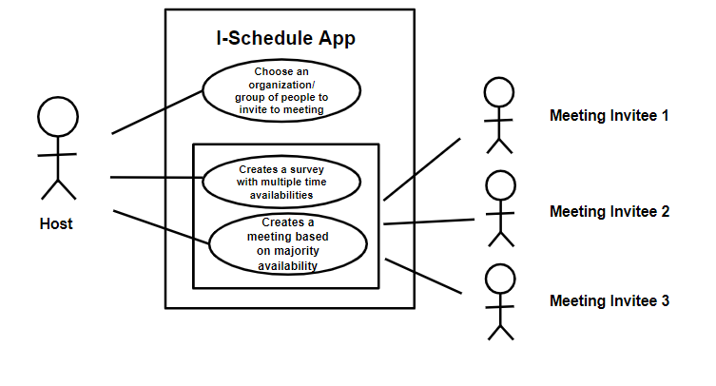
Use Case Diagram 2- Creating meeting with multiple invitees
Receive survey
Receive survey
Receive survey
Sends back counter times

Slide 5
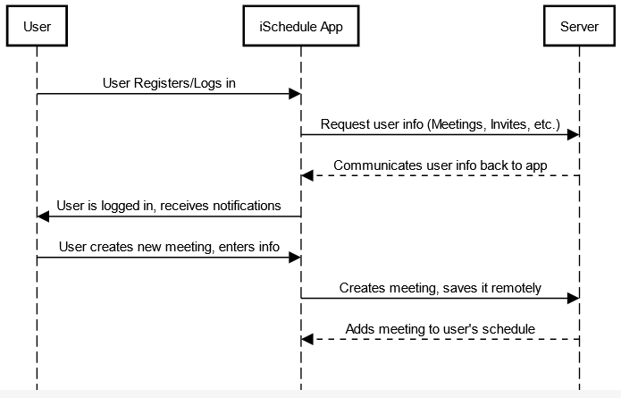
Test Case Scenarios
Scenario 1: A new user needs to join a meeting using an invite sent to their email. The user accepts the invite and is sent to the registration page. Once the user’s account is set up, they are automatically added to the meeting and will either be queried for their availability or have the set time and date for the meeting added to their calendar. The system will process the user’s feedback and communicate this to the host user.
Initial meeting invite could get lost in spam or go unnoticed
Interruption of internet connection user side; user response may need to be stored locally temporarily
Interruption of internet connection server side; ensure notifications and other functions will still work in case of interruption
Possible software version issues with legacy Android and iOS devices
Stress test system (Large meetings, Multiple scheduled meetings)
Scenario 2: An existing user wants to create a meeting and invite multiple people. The user logs into the iSchedule application, fills out the required information to create a meeting and creates the meeting. This information is communicated to the server, and the involved users are sent invites to the meeting. If the users’ email/phone is already registered with iSchedule, it sends an email/SMS notification to them and adds the meeting to their calendar and sends them a notification. If the user is not registered, then a message is sent to their email with a link to the registration page, and the user is automatically added to the meeting upon registering.

Slide 6
Thank You

